Slide 1
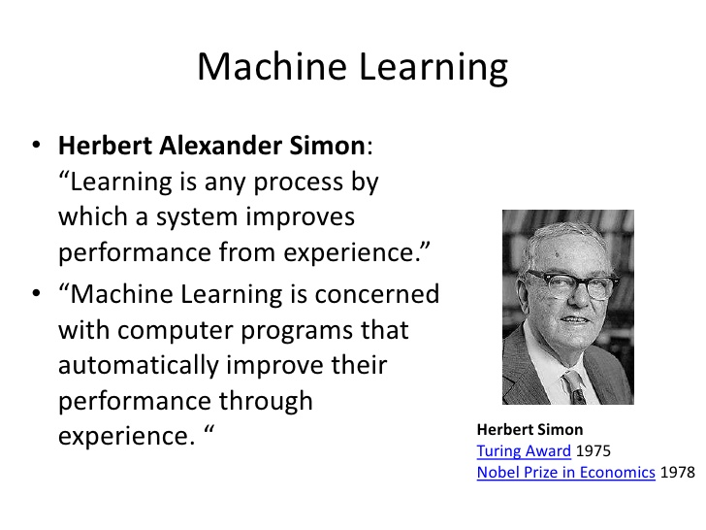

Slide 2
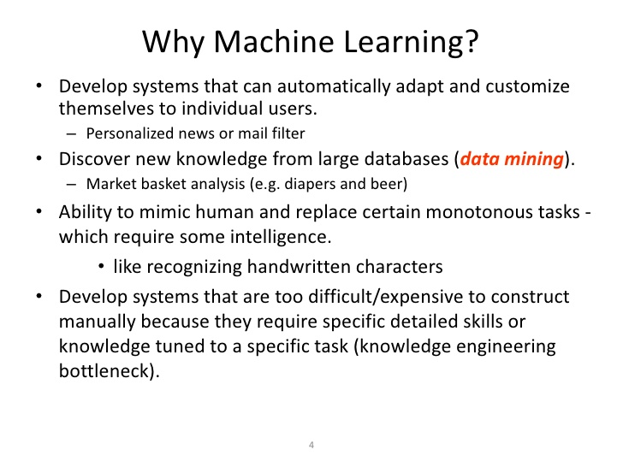

Slide 3
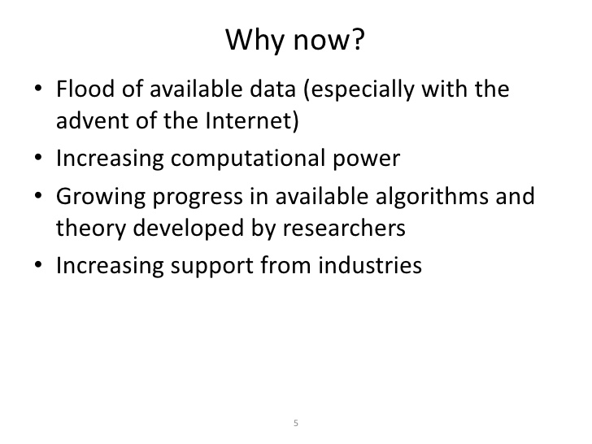

Slide 4
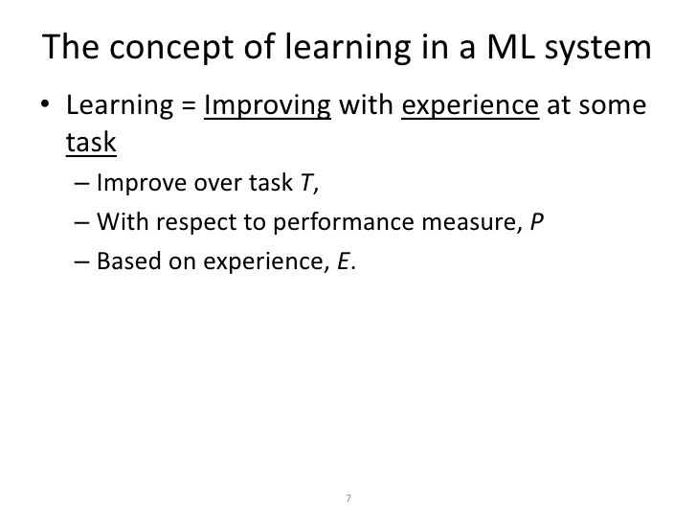

Slide 5
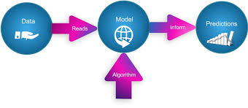
How the machine algorithms works?

Slide 6
Supervised Learning Vs Unsupervised Learning
Supervised Learning
Unsupervised Learning
Input variables and output variables will be given.
Supervised learning goal is to determine the function so well that when new input data set given, can predict the output.
Example:
Classification
Regression
Linear Regression
Support vector machine
Only input data will be given
The unsupervised learning goal is to model the hidden patterns or underlying structure in the given input data in order to learn about the data.
Example:
Clustering
Association
k-means
Association

Slide 7
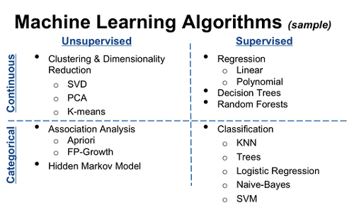

Slide 8
Classification Algorithm

Slide 9
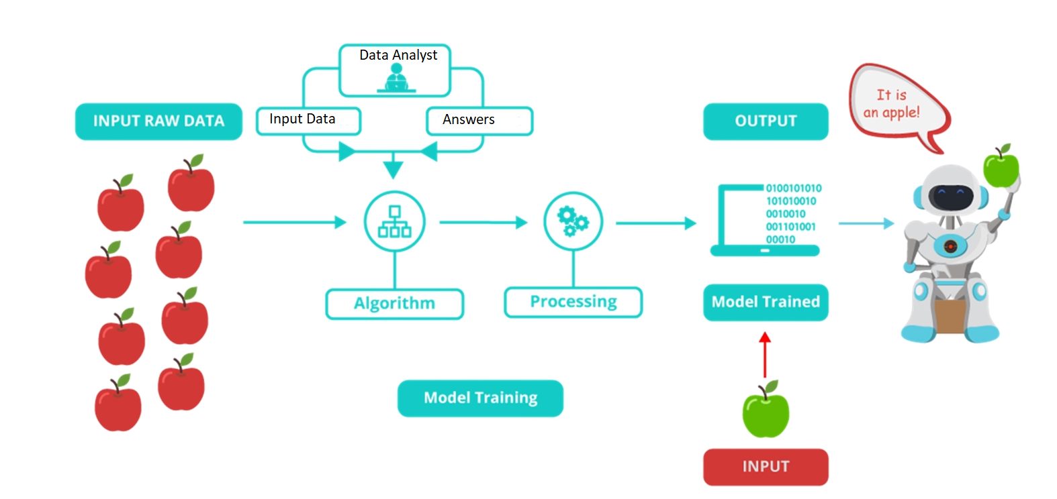
How classification Algorithm works?

Slide 10
Classification Models
Logistic Regression classification
K Nearest Neighbors classification.
Naive Bayes classification.
Decision Tree Classification.
Random Forest Classification.
Confusion Matrix.

Slide 11
Logistic Regression classification

Slide 12
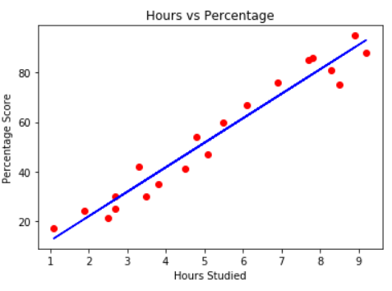
You can see over here that if X increases then the value of Y also increases.
Lets discuss this with example-
Lets say we have a data on X axis till 7 and somebody asked you that what would be the value of y when X is 8 and 9. Then how we can solve this is by fitting a straight line or by regression.
And the formula for straight line is :
y= mx + c
Using this we can try to predict the value of y.
If you have notice here that x variable can increase as much as it can but y variable will increase according to x.
So y is basically dependent upon your x variable.
This type of problem can be solved by regression.

Slide 13
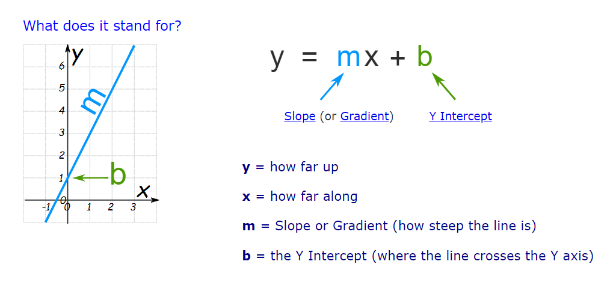
Linear Equation

Slide 14
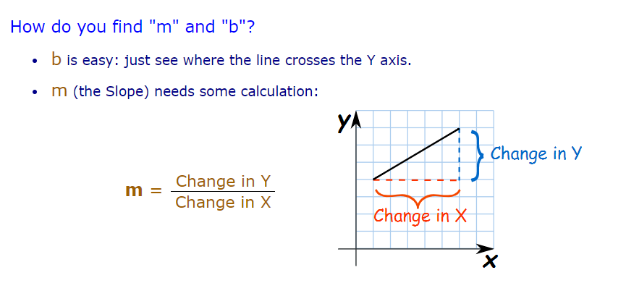

Slide 15
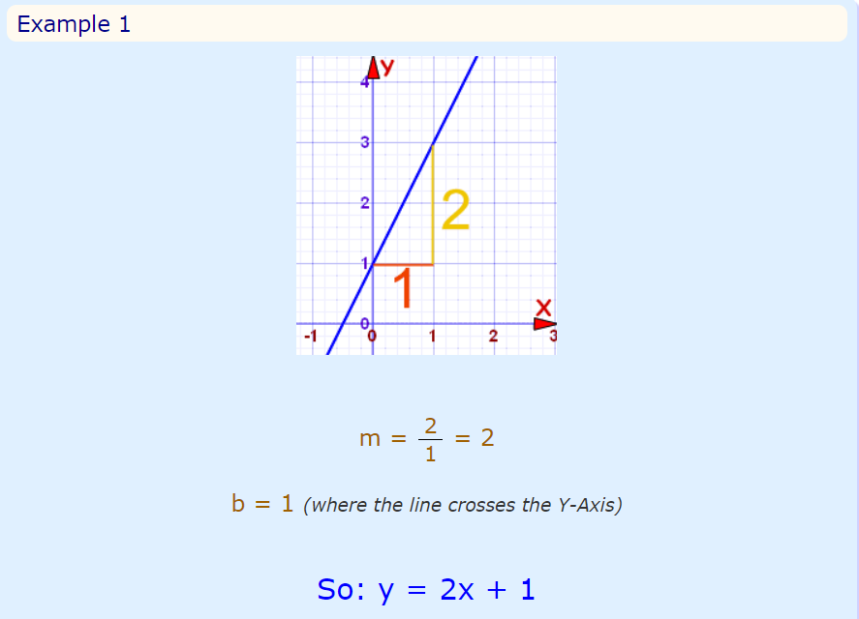

Slide 16
Dependent and Independent Variable
Dependent variable is a variable which we want to predict.
Independent variable are features on the basis of which we predict dependent variable.

Slide 17
What is Logistic Regression and Why to use Logistic Regression?

Slide 18
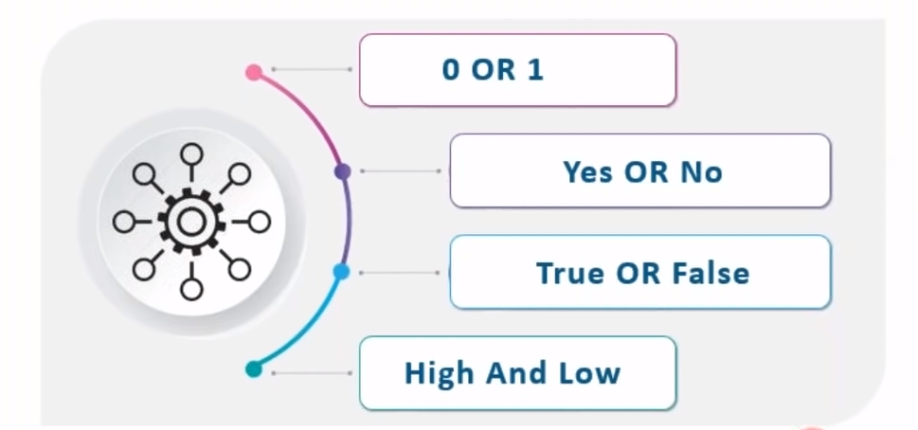
Logistic Regression will always give output in a binary form

Slide 19
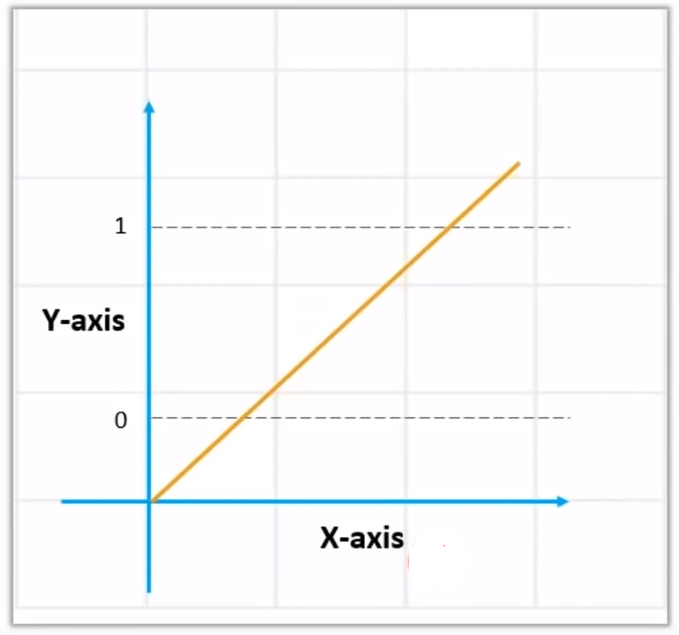
Now what is Linear Regression?
Linear regression will be used when there are values in a range.
If we use linear regression here then the value of y below 0 and values above 1 will not get entertained means we don’t need the value below 0 and above 1.
But in logistic regression values can either be 0 or 1 . It can’t be in range.

Slide 20
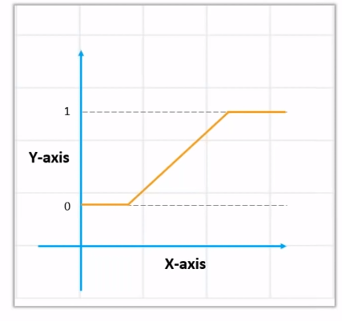
Logistic Regression
After clipping the Linear graph , it would look like this.
Here the outcome is either 0 or 1

Slide 21
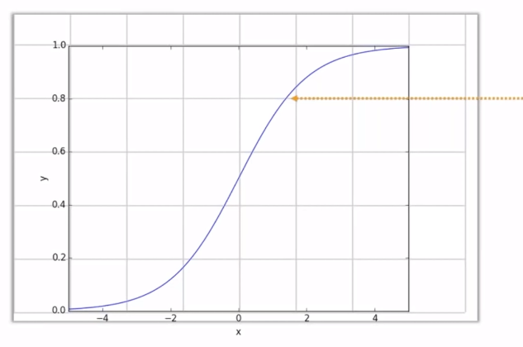
Sigmoid curve
Sigmoid curve
Now here values are between 0 and 1 but what if we have value 0.7 .

Slide 22
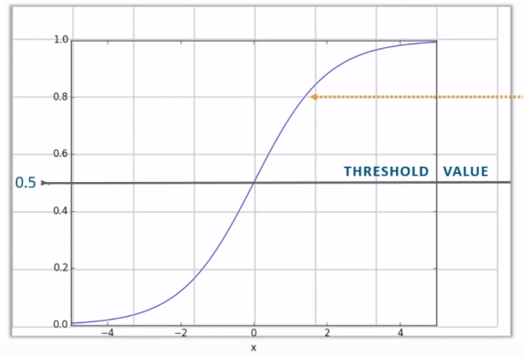
We will simply check if the value is more than the threshold value then value should be rounded of to 1 and if the value is less than threshold value then the result should be 0.
To make this curve we need to solve the equation

Slide 23
Difference between Linear Regression and Logistic Regression

Slide 24
Difference between Linear and Logistic Regression
Linear Regression | Logistic Regression
Continuous data – The value of y will be a continuous data. | Categorial data means discrete data means (0 or 1) Eg:- Is it raining outside or not? whether you are going to office or not today
Solves Regression problems- here the values you need to predict is in a range | Solve classification problems- here you need to predict discrete values(0 or 1)
Graph is straight line – We are predicting y on the basis of x variable | S shape graph- Over here we are classifying our output using sigmoid function

Slide 25
Use cases where Logistic regression is used
In Weather forecasting:
Logistic regression is used to tell us
-whether it is rain or not
-whether it is humid outside
-If person is earning 3 lac a month, whether that person is eligible for loan
But if we use Linear regression for weather forecasting then it will predict
What will be the temperature tomorrow?
What is the salary of a person if the person is from medical line?
How much amount of loan can person get if his monthly income is 3 lac?

Slide 26
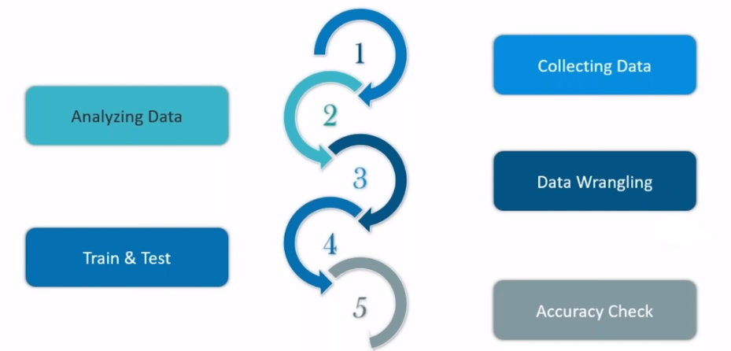
Steps to perform Algorithms

Slide 27
Use Case – Pima diabetes
Data characteristics:
The database contains only data about female patients who are of Pima Indian heritage are 21 or older
All the attributes are numeric
The data may contain invalid or null values
Total number of cases presented are 786
Class distribution: 0 : 500 1 : 268
Columns
pregnancies - Number of times pregnant
Glucose - Plasma glucose concentration a 2 hours in an oral glucose tolerance test
BloodPressure - Diastolic blood pressure (mm Hg)
SkinThickness - Triceps skin fold thickness (mm)
Insulin - 2-Hour serum insulin (mu U/ml)
BMI - Body mass index (weight in kg/(height in m)^2)
DiabetesPedigreeFunction - Diabetes pedigree function
Age - Age (years)
Outcome - Class variable (0 or 1) class value 1 is interpreted as "tested positive for diabetes

Slide 28
import numpy as np
import matplotlib.pyplot as plt
import pandas as pd
import seaborn as sns
data_diabetes = pd.read_csv ('diabetes.csv’)
data_diabetes.shape # (768, 9)

Slide 29
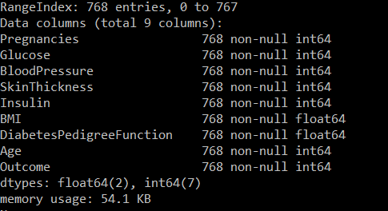
print(data_diabetes.info())
Output will be:

Slide 30
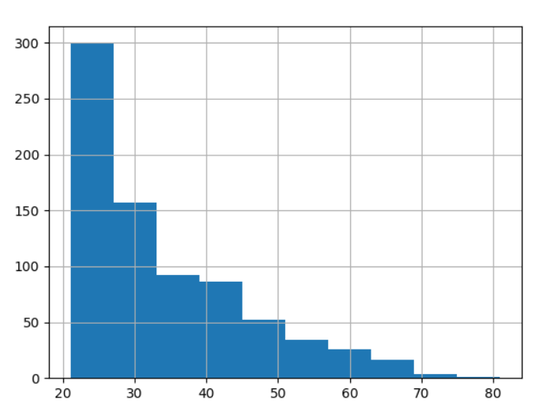
Analysing data with pandas
Analysis on Age
data_diabetes['Age'].hist()
plt.show()
We have analysed that dataset contains more records of women within a age group of 21 to 28 years and very lesser records of age group 70.

Slide 31
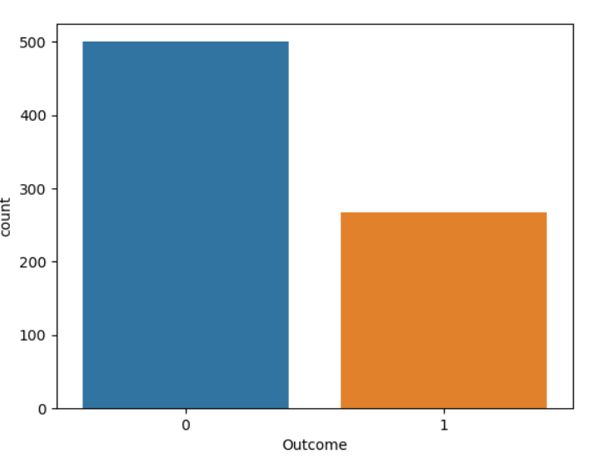

Analysing the outcome column
print(data_diabetes['Outcome'].value_counts())
sns.countplot(data_diabetes['Outcome'])
plt.show()

Slide 32
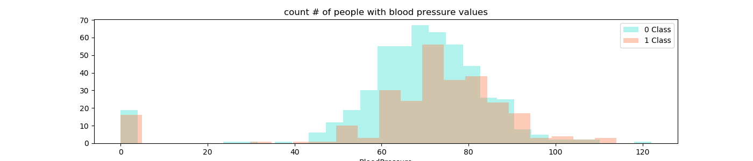
Analysis on Blood Pressure level
plt.figure(figsize=(14,3))
sns.distplot(data_diabetes[data_diabetes.Outcome == 0]['BloodPressure'], color='turquoise', kde=False, label='0 Class')
sns.distplot(data_diabetes[data_diabetes.Outcome == 1]['BloodPressure'], color='coral', kde=False, label='1 Class')
plt.legend()
plt.title('count # of people with blood pressure values')
plt.show()

Slide 33
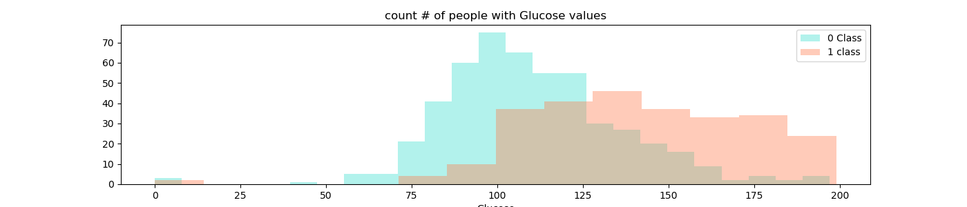
Analysis on Glucose column
plt.figure(figsize=(14,3))
sns.distplot(data_diabetes[data_diabetes.Outcome == 0]['Glucose'], color='turquoise', kde=False, label='0 Class')
sns.distplot(data_diabetes[data_diabetes.Outcome == 1]['Glucose'], color='coral', kde=False, label='1 class')
plt.legend()
plt.title('count # of people with Glucose values')

Slide 34
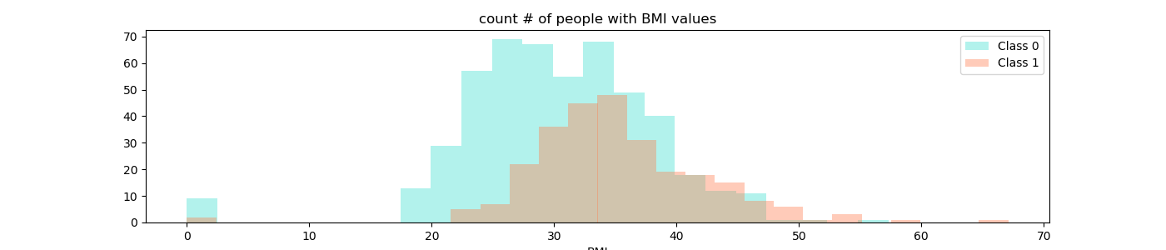
BMI Analysis (Body Mass Index)
plt.figure(figsize=(14,3))
sns.distplot(data_diabetes[data_diabetes.Outcome == 0]['BMI'], color='turquoise', kde=False, label='Class 0')
sns.distplot(data_diabetes[data_diabetes.Outcome == 1]['BMI'], color='coral', kde=False, label='Class 1')
plt.legend()
plt.title('count # of people with BMI values')
plt.show()

Slide 35
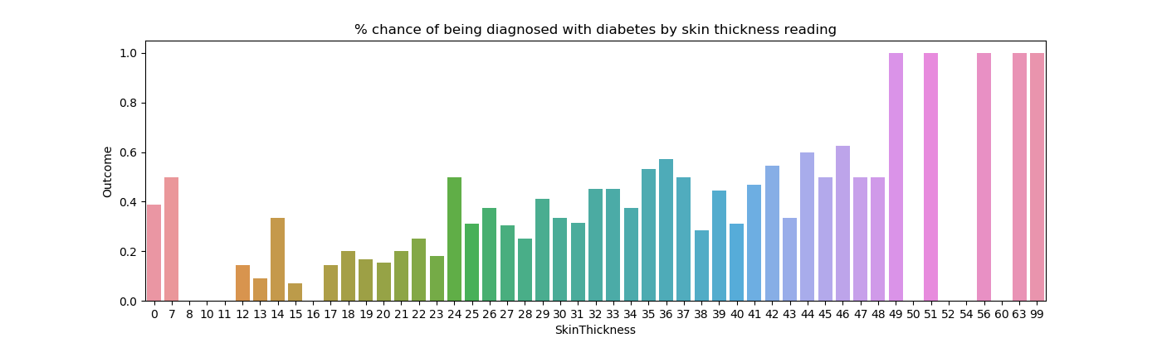
Chances of diabetes with respect to skin thickness
plt.figure(figsize=(14,3))
SkinThickness_pivot = data_diabetes.groupby('SkinThickness').Outcome.mean().reset_index()
sns.barplot(SkinThickness_pivot.SkinThickness, SkinThickness_pivot.Outcome)
plt.title('% chance of being diagnosed with diabetes by skin thickness reading')
plt.show()

Slide 36
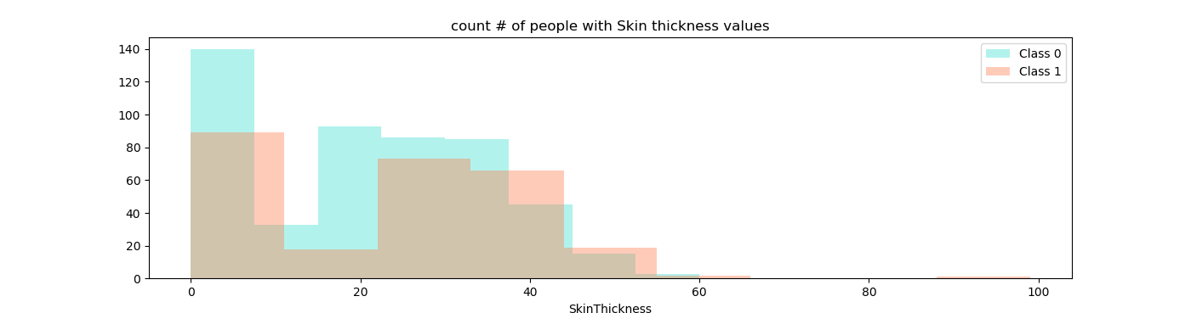
Skin thickness analysis
plt.figure(figsize=(14,3))
sns.distplot(data_diabetes[data_diabetes.Outcome == 0]['SkinThickness'], color='turquoise', kde=False, label='Class 0')
sns.distplot(data_diabetes[data_diabetes.Outcome == 1]['SkinThickness'], color='coral', kde=False, label='Class 1')
plt.legend()
plt.title('count # of people with Skin thickness values')
plt.show()

Slide 37
Dependent and Independent Variable
#X = ['Pregnancies','Glucose','DiabetesPedigreeFunction','Insulin','BMI','Age']
X = data_diabetes.iloc[:,0:8]
print(X.head())
#Y=data_diabetes['Outcome']
Y=data_diabetes.iloc[:,8]
print(Y.head())

Slide 38

# split the dataset into training and test set. We will use 80/20 approach #==============================================================================
from sklearn.model_selection import train_test_split
X_train, X_test, y_train, y_test = train_test_split (X, Y, test_size = .20)
print("Size of X_train is",X_train.shape)
print("Size of y_train is",y_train.shape)
print("Size of X_test is",X_test.shape)
print("Size of y_test is",y_test.shape)

Slide 39
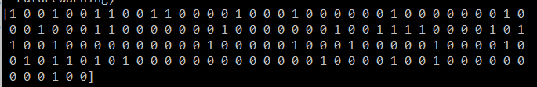
# Fit the Logistic regression to the train data. Logistic regression is a
# linear classifier after which the data is divided by a straight line.
from sklearn.linear_model import LogisticRegression
LRClassifier = LogisticRegression (random_state = 0)
LRClassifier.fit (X_train, y_train)
# Predict the values
prediction = LRClassifier.predict (X_test)
print(prediction)
Output:

Slide 40
Checking accuracy of our model
from sklearn.metrics import accuracy_score
print("Accuracy is",accuracy_score(y_test, prediction))

Slide 41
Classification: Applications
Aka Pattern recognition
Face recognition: Pose, lighting, occlusion (glasses, beard), make-up, hair style
Character recognition: Different handwriting styles.
Speech recognition: Temporal dependency.
Use of a dictionary or the syntax of the language.
Sensor fusion: Combine multiple modalities; eg, visual (lip image) and acoustic for speech
Medical diagnosis: From symptoms to illnesses
Web Advertizing: Predict if a user clicks on an ad on the Internet.

